Slide 1
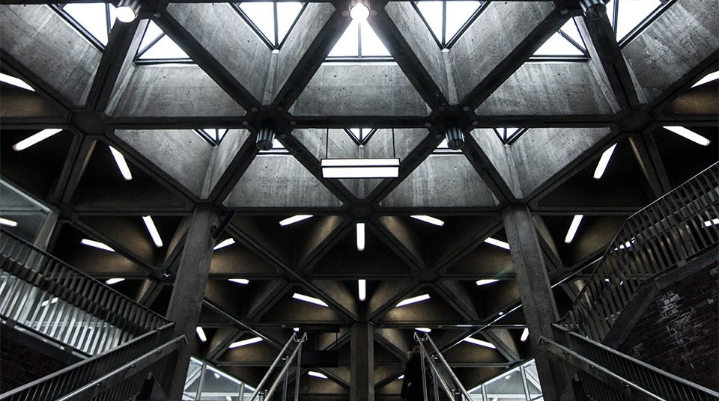
SCREEN DESIGN
2
+
2
+
Human Computer Interaction
19SW50

Slide 2

SCREEN DESIGN
2
+
INTRODUCTION
Screen design refers to the graphic design and layout of user interfaces on displays. It is a sub-area of user interface design but is limited to monitors and displays.
In screen design, the focus is on maximizing usability and user experience by making user interaction as simple and efficient as possible.

Slide 3
Cont..
2
+
Screen design includes a wide variety of applications where screens or displays can be used as part of human-machine interaction. Technical background functions do not matter in screen design. You could say that screen design thus makes the functionality specified in the context of web design applicable to users.

Slide 4
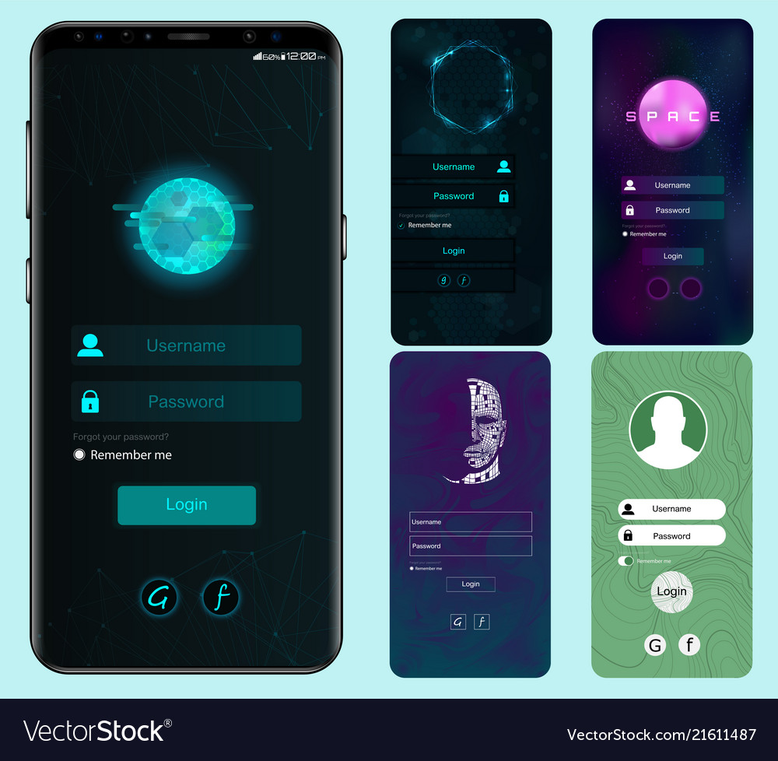
Login page screen layout

Slide 5

Central Approach
2
+
central approach in screen design is orientation to the target group’s needs and abilities. This means that designers must know and understand the skills and habits as well as the senses of users.
Screen design will typically differ depending on whether it is designed for older people, children, or adults.
Someone who deals with a particular device on a daily basis will have less difficulty using complicated screens than someone who is less familiar with them.

Slide 6
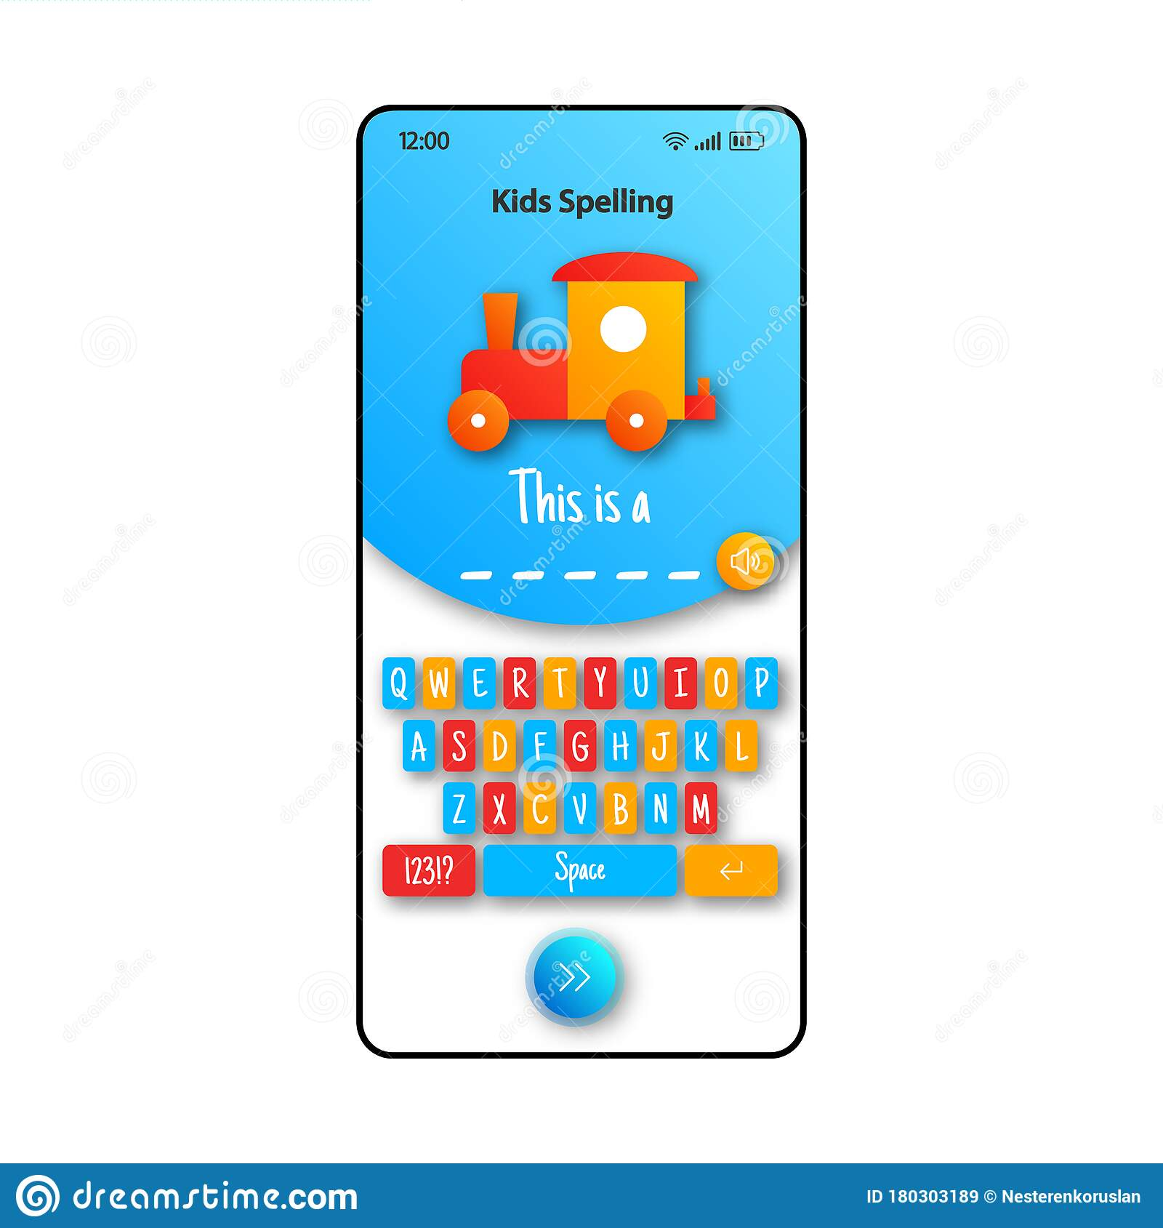
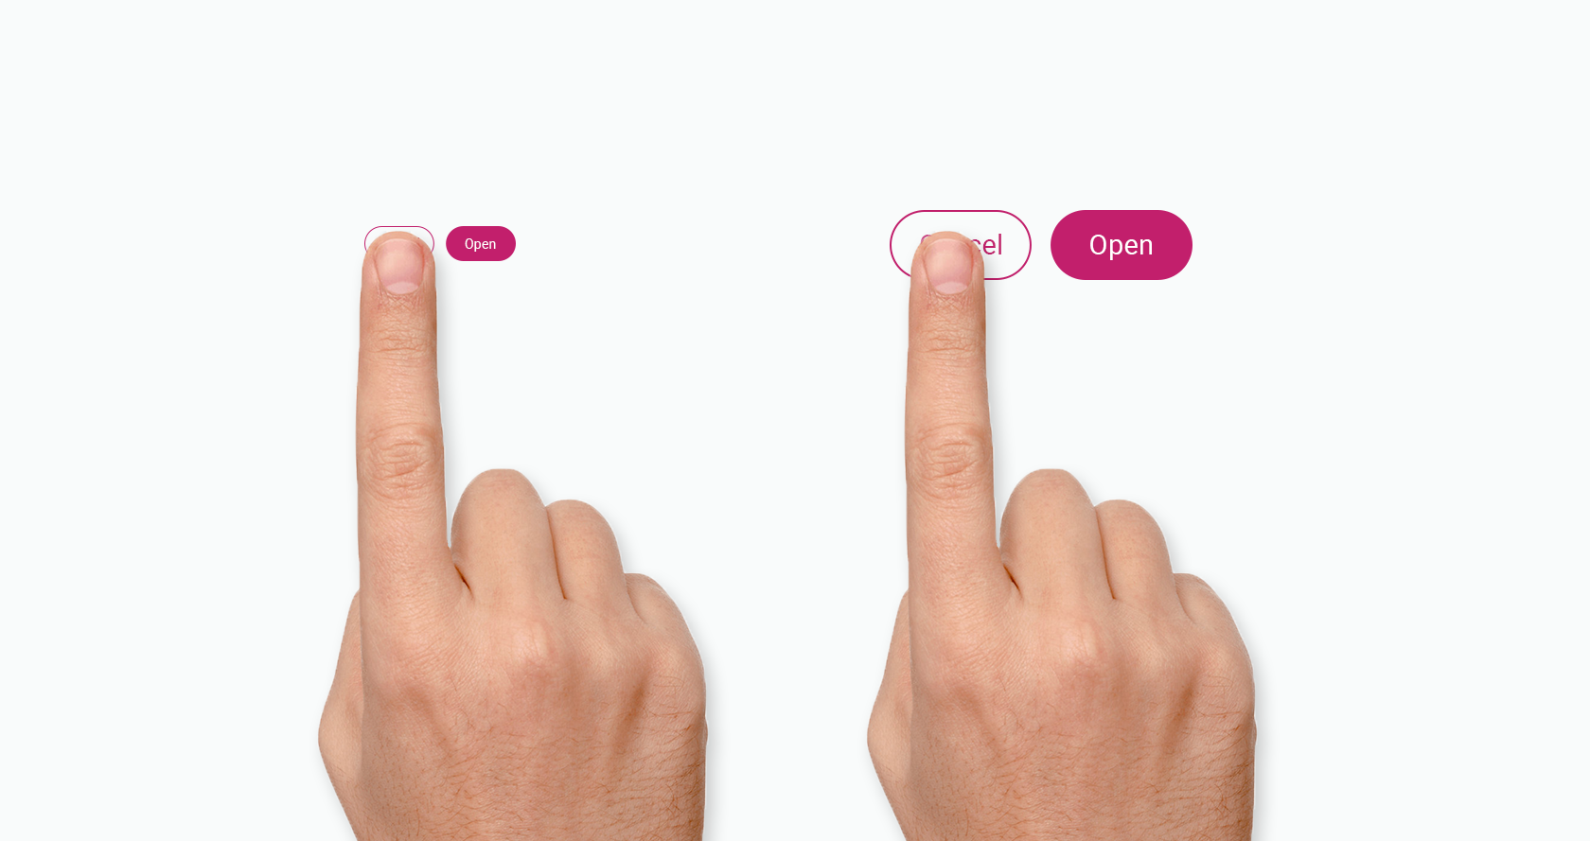
users
Elder people
Children

Slide 7
Good Screen Design
Bad Screen Design
As a general rule of thumb, there are ‘4 E’s’ of good UI design:
Easy to use
Easy to understand
Error-free
Effective for end-goal (buying your product)
Sluggish and unresponsive – interaction will be slow and clunky
Complicated –
Confusing –
Inconsistent design – pages will look different, throwing users off
No target – there is no clear audience for the website
Readability issues –Make sure font size is big enough, the actual font itself is appropriate, and your colour-scheme makes it easy to read what’s on your website.

Slide 8
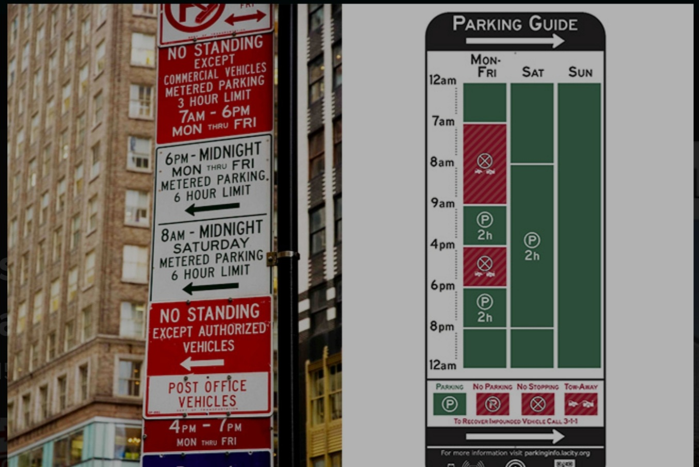
Bad Screen Design
Good Screen Design
Information overload:
Parking signs in Los angles
Information precise:
nikki sylianteng parking signs

Slide 9

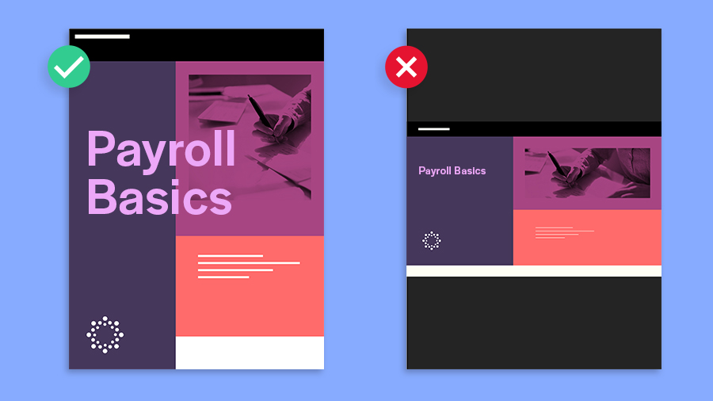
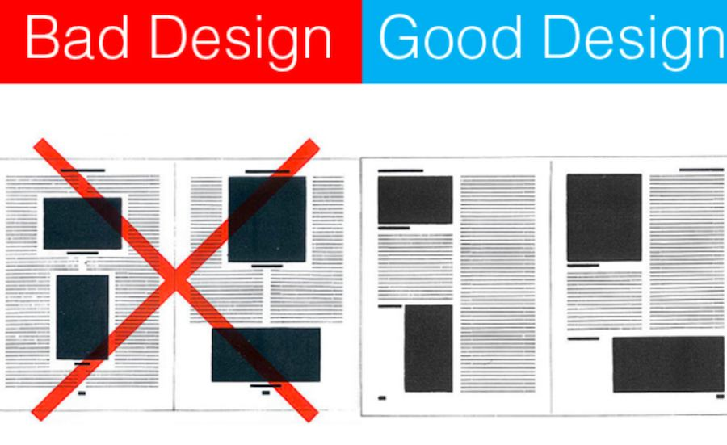
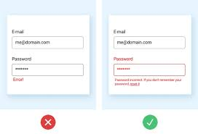
Good versus Bad Design
2
+

Slide 10
Layout design guidelines
2
+
grouping of items
order of items
decoration - fonts, boxes etc.
alignment of items
white space between items
Distinguish captions & fields

Slide 11
Text design guidelines
2
+
Message
Instructional prompts
Instructions
Screen number
Font
Color
Information presentation
Visual Organization

Slide 12
Applications of screen design
2
+
Screen design is used in mobile and desktop versions of websites, apps, and any graphical user interface displayed on monitors or displays that enable users to interact with electronic devices.
This includes computers, portable media players, gaming devices, smartphones, and household, office, or industrial controls.

Slide 13
THANK YOU
2
+
2
+
ANY QUESTION???

